Slide 1


Social Buzz Data Insights

Slide 2


Today's agenda
Project recap
Problem
The Analytics team
Process
Insights
Summary

Slide 3

We are excited to embark on a 3-month engagement with Social Buzz, a prominent player in the social media and content creation industry. Founded in 2010 by two former engineers, Social Buzz has rapidly grown to reach over 500 million active users each month. Our mission is to assist Social Buzz in addressing three critical challenges and lay the foundation for a successful partnership.
Project Recap

Slide 4

Problem
Scaling Challenges: With rapid growth and vast amounts of unstructured data generated daily, Social Buzz faces the daunting task of managing and analyzing their data efficiently. They require a scalable solution to sustain their expansion.
IPO Preparation: Social Buzz aims to complete an IPO by the end of next year. They seek expert guidance to navigate the complexities of the IPO process, ensuring a smooth transition to becoming a publicly traded company.
Big Data Management: The nature of Social Buzz's business involves handling massive amounts of data. They are eager to learn data best practices from industry leaders to optimize data management.

Slide 5




Parimal Kolhe
Data Analyst
The Analytics team
Marcus Rompton
Senior Principle
Andrew Fleming
Chief Technical Architect

Slide 6
Process
1
Data Understanding: We'll delve into Social Buzz's data landscape to grasp its sources and structure.
2
Data Cleaning: Cleaning and organizing data for accuracy and reliability.​
3
Data Modeling: Developing tailored data models for efficient analysis.​​
4
Data Analysis: Extracting trends, patterns, and insights from the data.
5
Uncover Insights: Turning data into actionable recommendations for Social Buzz's growth and IPO preparation.​​​​

Slide 7


Insights

Slide 8
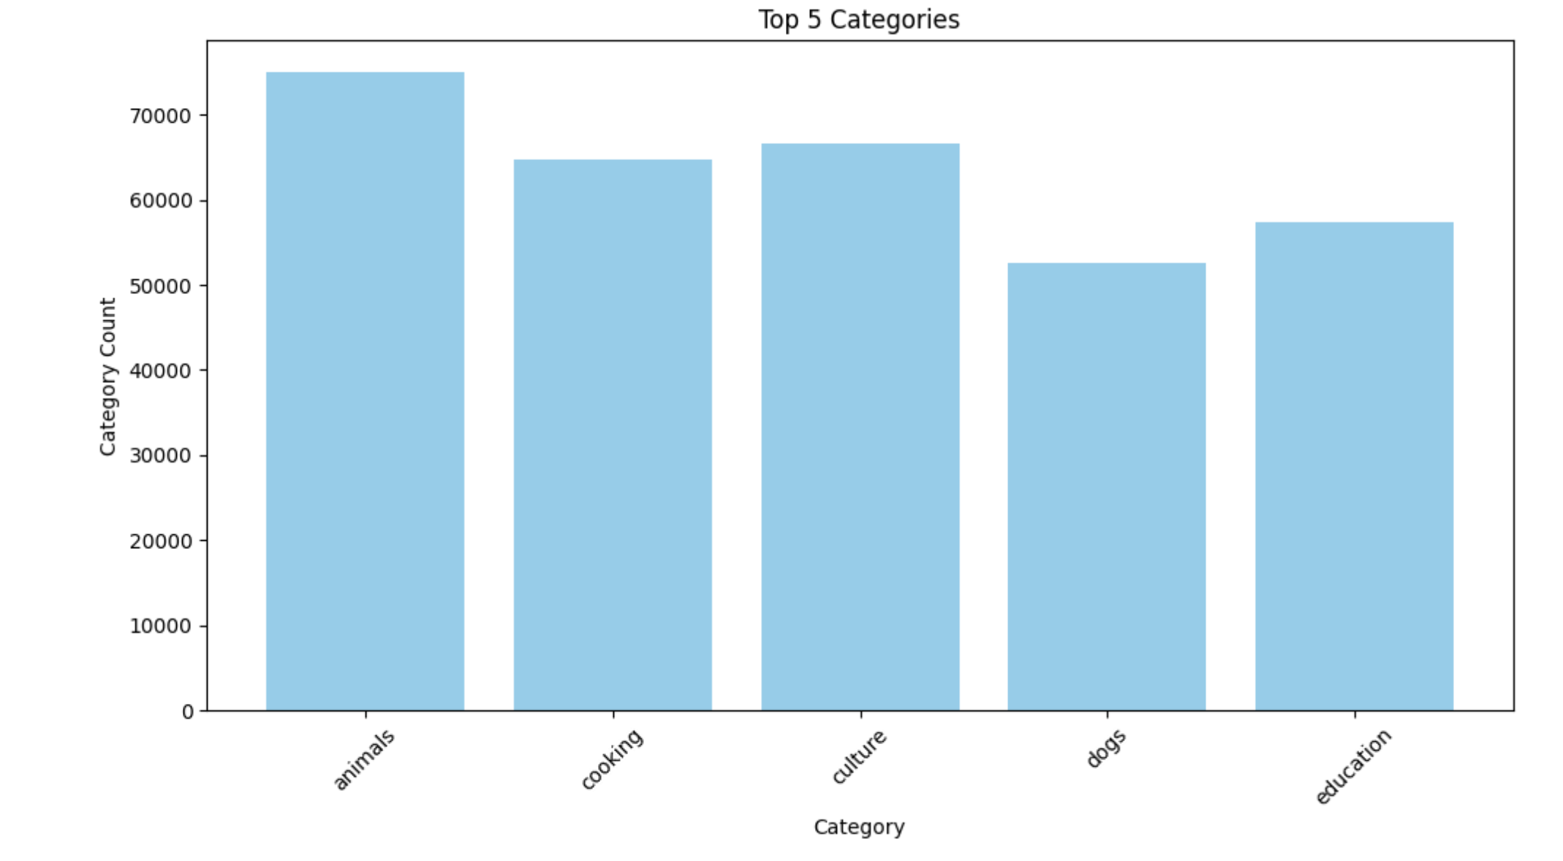
Top Performing Categories
Animal is the most Performing Category

Slide 9
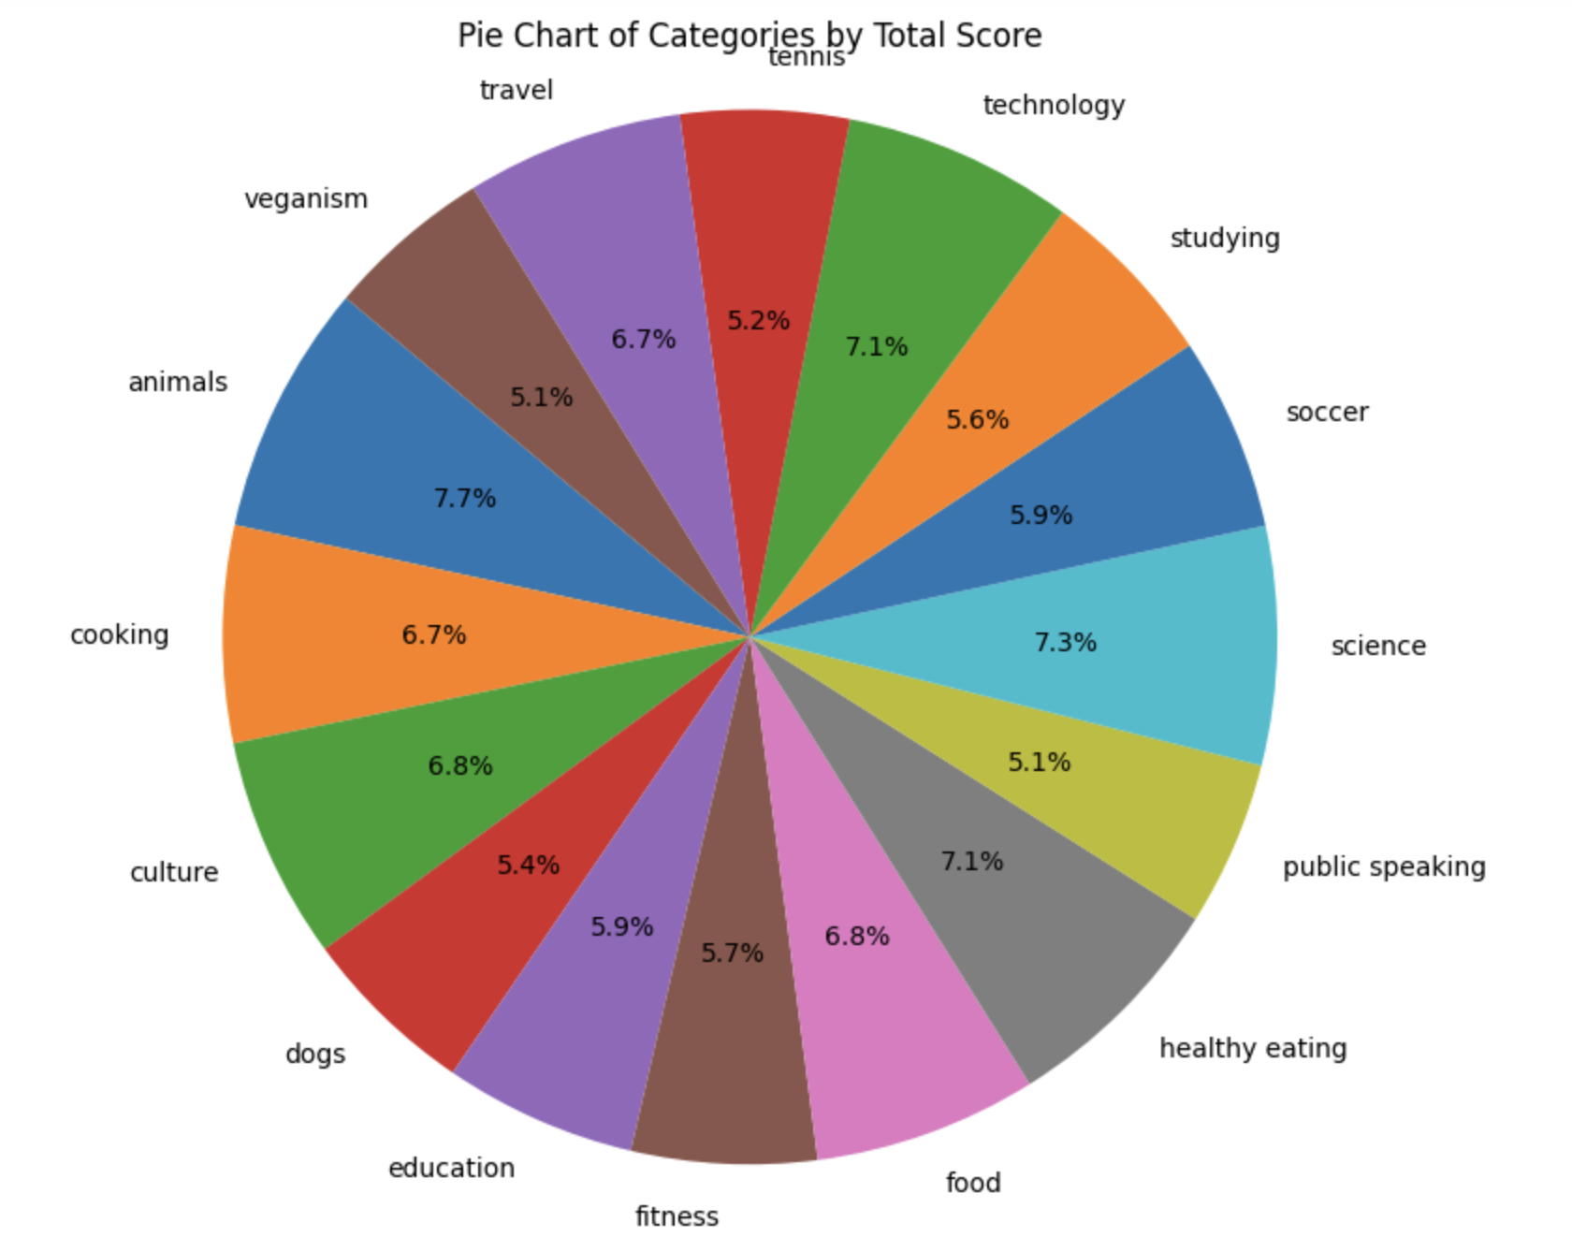
Contribution of Various Categories
Each Category has contributed in the range (5-8)%

Slide 10
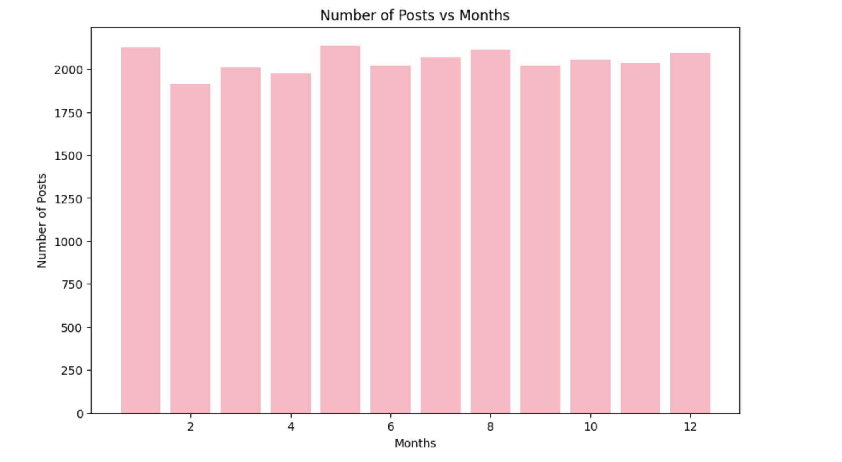
Most Active Months
The most active month by the number of Posts is May

Slide 11
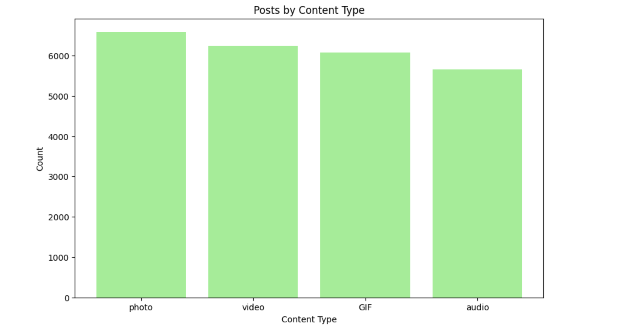
Top Content Type
Photos is the most widely used Content Type and hence it can be concluded Most users mainly share Photos.

Slide 12
Suggestions
Maximize Animal Category: Leverage the Animal category's success.
Maintain Category Balance: Encourage engagement across all categories.
Promote May: Run special campaigns in May to boost activity.
Optimize Photo Sharing: Improve photo-sharing features.
Gather User Feedback: Continuously seek user input.
Strategic Marketing: Promote strengths in marketing efforts.

Slide 13

Animal Category Dominates Performance: The Animal category stands out as the most performing category on Social Buzz.
Even Contribution Across Categories: Each category has contributed to the platform's performance, with all categories falling within the range of 5-8% in terms of their contribution.
May is the Most Active Month: May emerges as the most active month on the platform based on the number of posts.
Photos Are the Preferred Content Type: Photos are the most widely used content type on Social Buzz, suggesting that most users primarily share photos.
Summary

Slide 14
Thank you!
ANY QUESTIONS?

